Slide 1
Machine Learning
Introduction to Correlation and Regression

Slide 2

Introduction to Correlation & Regression
Correlation is a statistical method used to determine whether a relationship between variables exists.
Regression is a statistical method used to describe the nature of the relationship between variables, that is, positive or negative, linear or nonlinear.

Slide 3
Introduction to Correlation & Regression
There are two types of relationships:
Simple relationship and
Multiple relationship
In a simple relationship, there are two variables—an independent variable, also called an explanatory variable or a predictor variable, and a dependent variable, also called a response variable.
For example, a manager may wish to see whether the number of years the sales people have been working for the company has anything to do with the amount of sales they make.

Slide 4
Introduction to Correlation & Regression
In a multiple relationship, called multiple regression, two or more independent variables are used to predict one dependent variable.
For example, an educator may wish to investigate the relationship between a student’s success in college and factors such as the number of hours devoted to studying, the student’s GPA, and the student’s high school background.

Slide 5
Introduction to Correlation & Regression
Simple relationships can also be positive or negative.
A positive relationship exists when both variables increase or decrease at the same time. For instance, a person’s height and weight are related; and the relationship is positive, since the taller a person is, generally, the more the person weighs.
In a negative relationship, as one variable increases, the other variable decreases, and vice versa. For example, if you measure the strength of people over 60 years of age, you will find that as age increases, strength generally decreases.

Slide 6
Machine Learning
Scatter Plots & Correlation

Slide 7
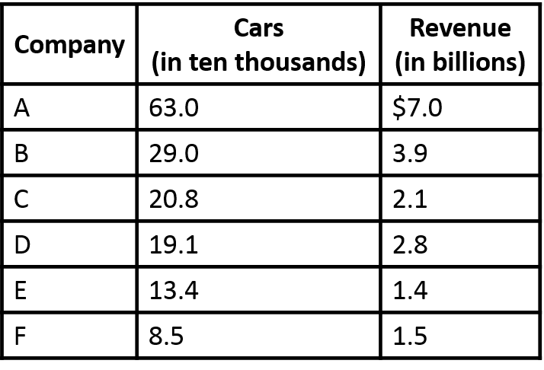
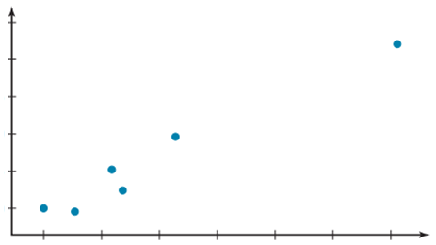
Scatter Plots & Correlation
A scatter plot is a graph of the ordered pairs (x, y) of numbers consisting of the independent variable x and the dependent variable y.
7.75
6.50
5.25
Revenue (billions)
4.00
2.75
1.50
8.5
17.5
26.5
35.5
44.5
53.5
62.5
Cars (in 10,000s)

Slide 8
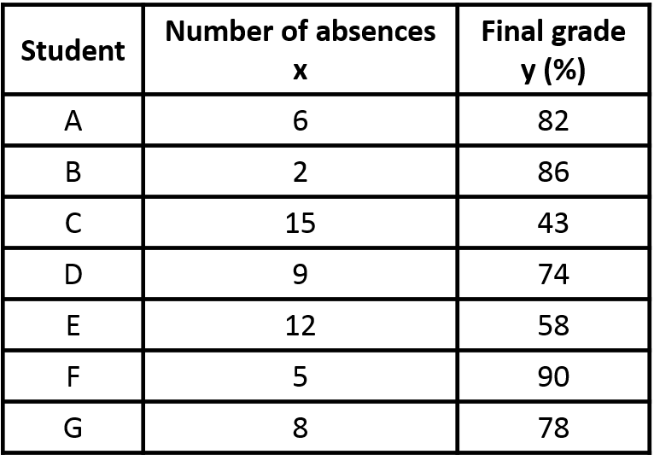
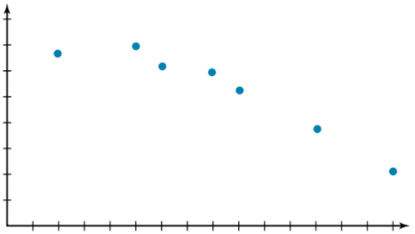
Scatter Plots and Correlation
Example:
y
100
90
80
70
60
Final Grade
50
40
30
x
0
1
2
3
4
5
6
7
8
9
10
11
12
13
14
15

Slide 9
Machine Learning
Correlation Coefficient

Slide 10
Correlation Coefficient
The correlation coefficient computed from the sample data measures the strength and direction of a linear relationship between two variables. The symbol for the sample correlation coefficient is r. The symbol for the population correlation coefficient is ρ (Greek letter rho).
Strong negative linear relationship
No linear relationship
Strong positive linear relationship
-1
0
+1

Slide 11
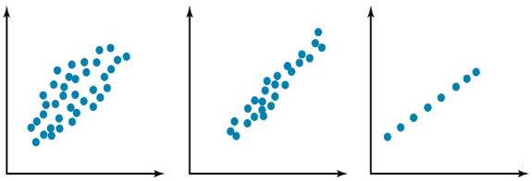
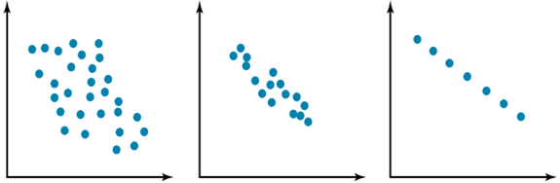
Correlation Coefficient
Relationship Between the Correlation Coefficient & the Scatter Plot
y
y
y
x
x
x
(a) r= 0.50
(b) r= 0.90
(c) r= 1.00
y
y
y
x
x
x
(d) r= -0.50
(e) r= -0.90
(f) r= -1.00

Slide 12
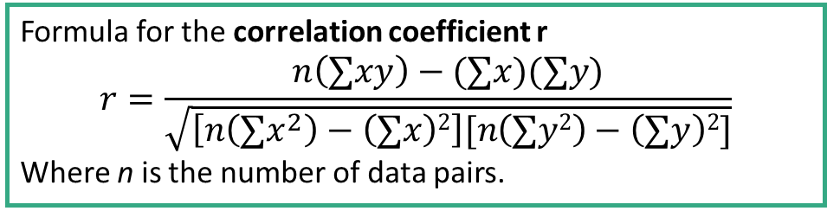
Correlation Coefficient
Formula for the correlation coefficient r
$$r=\frac{n\left(∑xy\right)−(∑x)(∑y)}{\sqrt{\left[n\left(∑x^{2}\right)−\left(∑x\right)2\right][n\left(∑y2\right)−\left(∑y\right)2]}}$$
Where n is the number of data pairs.

Slide 13
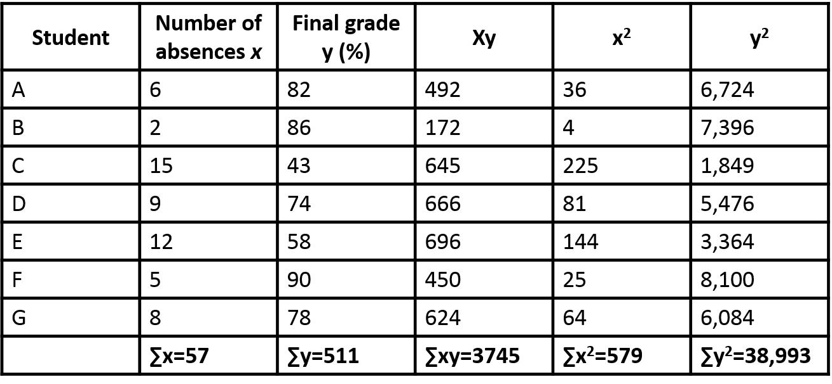
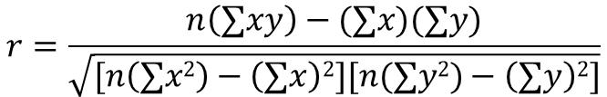
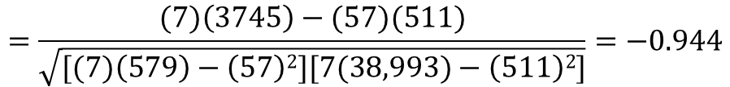
Correlation Coefficient
Example:
Substitute in the formula and solve for r.
$$r=\frac{n\left(∑xy\right)−(∑x)(∑y)}{\sqrt{[n\left(∑x2\right)−\left(∑x\right)2][n(∑y2)−\left(∑y\right)2]}}$$
$$=\frac{(7)\left(3745\right)−(57)(511)}{\sqrt{[(7)\left(579\right)−\left(57\right)2][7(38,993)−\left(511\right)2]}}=−0.944$$

Slide 14
Machine Learning
Regression: Line of Best Fit

Slide 15
Regression: Line of Best Fit
In studying relationships between two variables, collect the data and then construct a scatter plot to determine the nature of the relationships (positive linear or negative linear or curvilinear, or no detectable relationships).
After calculating correlation coefficient is to test the significance of the relationship.
If the value of the correlation coefficient is significant, the next step is to determine the equation of the regression line, which is the data’s line of best fit.

Slide 16
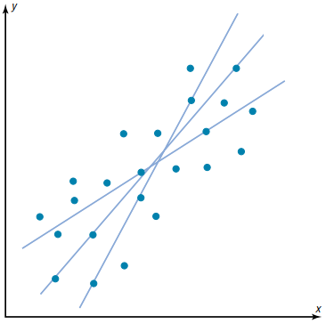
Regression: Line of Best Fit
The reason to need a line of best fit is that the values of y will be predicted from the values of x; hence, the closer points are to the line, the better the fit and the prediction will be.
y
x

Slide 17
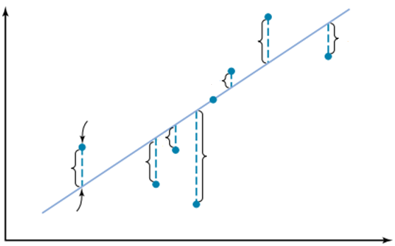







Regression: Line of Best Fit
The reason to need a line of best fit is that the values of y will be predicted from the values of x; hence, the closer the points are to the line, the better the fit and the prediction will be.
y
$$d_{6}$$
$$d_{7}$$
$$d_{5}$$
Observed value
$$d_{3}$$
$$d_{2}$$
$$d_{4}$$
$$d_{1}$$
Predicated value
x

Slide 18
Machine Learning
Regression Line Equation

Slide 19
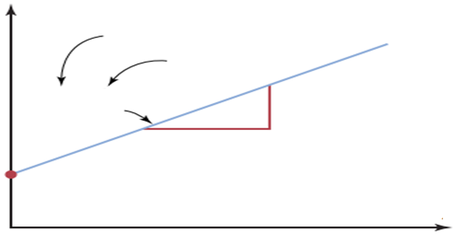
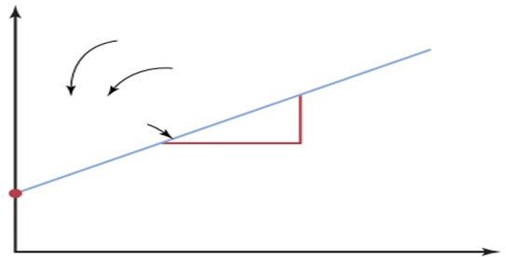






Regression Line Equation
A line as represented in Algebra and in Statistics
y
Slope
y
Intercept
y = mx + c
y = 0.5x + 5
$$△y=2$$
$$△x=4$$
$$m=\frac{△y}{△x}=\frac{2}{4}=0.5$$
x
(a) Algebra of a line
y’
y’
Intercept
Slope
y’ = a + bx
$$△y′=2$$
y’ = 5 + 0.5x
$$△x=4$$
$$b=\frac{△y′}{△x}=\frac{2}{4}=0.5$$
x
(b) Statistical notation for a regression line

Slide 20


Regression Line Equation
Formulas for the Regression Line
y’ = a + bx
where,
Where a is the y’ intercept and b is the slope of the line.
$$a=\frac{\left(∑y\right)\left(∑x2\right)−(∑x)(∑xy)}{n\left(∑x2\right)−\left(∑x\right)2}$$
$$b=\frac{n\left(∑xy\right)−(∑x)(∑xy)}{n\left(∑x2\right)−\left(∑x\right)2}$$

Slide 21


Regression Line Equation
Example:
Substitute in the formula and solve for r:
$$r=\frac{n\left(∑xy\right)−(∑x)(∑y)}{\sqrt{[n\left(∑x2\right)−\left(∑x\right)2][n(∑y2)−\left(∑y\right)2]}}$$
$$=\frac{(7)\left(3745\right)−(57)(511)}{\sqrt{[(7)\left(579\right)−\left(57\right)2][7(38,993)−\left(511\right)2]}}=−0.944$$
$a=\frac{\left(∑y\right)(∑x2)−(∑x)(∑xy)}{n\left(∑x2\right)−\left(∑x\right)2}=\frac{\left(511\right)\left(579\right)−(57)(3745)}{\left(7\right)\left(579\right)−\left(57\right)2}=102.493$
$b=\frac{n\left(∑xy\right)−(∑x)(∑y)}{n\left(∑x2\right)−\left(∑x\right)2}=\frac{\left(7\right)\left(3745\right)−(57)(3745)}{\left(7\right)\left(579\right)−\left(57\right)2}=−3.622$
Hence, the equation of the regression line y’=a + bx is
y’=102.493 – 3.622x

Slide 22
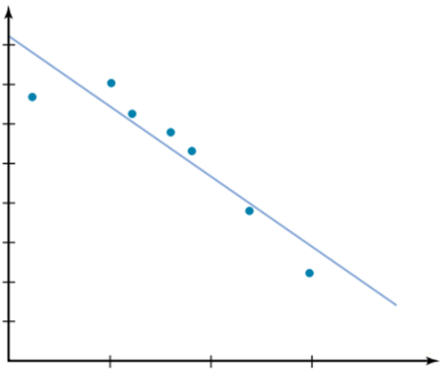
Regression Line Equation
Regression Line for the Example:
100
90
80
70
Final grade
y’=102.493 – 3.622x
60
50
40
30
0
5
10
15
Number of absences

Slide 23
Regression Model
The regression model is
Data about x and y are obtained from a sample.
From the sample of values of x and y, estimates b0 of β0 and b1 of β1 are obtained using the least squares or another method.
The resulting estimate of the model is
The symbol is termed “y hat” and refers to the predicted values of the dependent variable y that are associated with values of x, given the linear model.

Slide 24
Machine Learning
Multiple Regression

Slide 25
Multiple Regression
Multiple Regression
In multiple regression, there are several independent variables and one dependent variable, and the equation is
y’ = a + b₁x₁ + b₂x₂ + • • • + b_{k}x_{k}
where x₁ , x₂ , … , x_{k} are the independent variables.

Slide 26
Bivariate & Multivariate Models
Bivariate or simple regression model
(Education) x y (Income)
Multivariate or multiple regression model
(Education)
(Sex)
(Experience)
(Age)
x₁
y
(Income)
x₂
x₃
x₄
Model with simultaneous relationship
Price of wheat
Quantity of wheat produced

Slide 27
Multiple Regression
Example:
The multiple regression equation obtained from the data is
If GPA=3.0 and Age=25, then predicted State board score =
So the predicted State board score is 581.
Student | GPA x₁ | Age x₂ | State board score y
A | 3.2 | 22 | 550
B | 2.7 | 27 | 570
C | 2.5 | 24 | 525
D | 3.4 | 28 | 670
E | 2.2 | 23 | 490
y’ = -44.81 + 87.64x₁ + 14.533x₂
y’ = -44.81 + 87.64 (3.0) + 14.533 (25)
= 581.44 or 581

Slide 28
Machine Learning
First Order Linear Model

Slide 29
First Order Linear Model
Y = b₀ + b₁X + ε
Y = dependent variable
X = independent variable
b₀ = y-intercept
b₁ = slope of the line
ε = error variable
The quantity ε is a random variable assumed to be normally distributed with E(ε) = 0 and V(ε) = σ².
Without ε, any observed pair (X, Y) would fall exactly on the line Y = b₀ + b₁X called the true regression line.
Let us go for a practical demonstration…

Slide 30
Machine Learning
Polynomial Regression

Slide 31
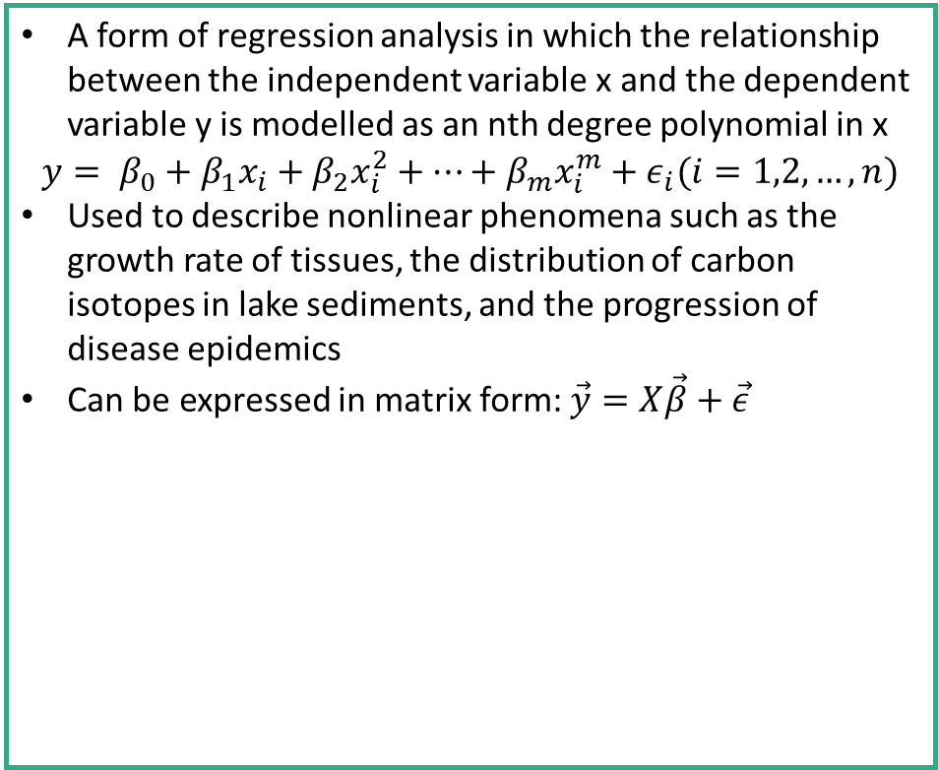




Polynomial Regression
A form of regression analysis in which the relationship between the independent variable x and the dependent variable y is modelled as an nth degree polynomial in x
$$y= β_{0}+β_{1}x_{i}+β_{2}x_{i}^{2}+…+β_{m}x_{i}^{m}+ε_{i}(i=1,2,…,n)$$
Used to describe nonlinear phenomena such as the growth rate of tissues, the distribution of carbon isotopes in lake sediments, and the progression of disease epidemics
Can be expressed in matrix form: $\vec{y}=X\vec{β}+\vec{ε}$
$$\left[\begin{aligned}y_{1} \\ y_{2} \\ y_{3} \\ . \\ . \\ . \\ y_{n}\end{aligned}\right]=$$
$$\left[\begin{aligned}β_{0} \\ β_{1} \\ β_{2} \\ . \\ . \\ . \\ β_{m}\end{aligned}\right]+$$
$$\left[\begin{aligned}ε_{1} \\ ε_{2} \\ ε_{3} \\ . \\ . \\ . \\ ε_{n}\end{aligned}\right]$$
$$\left[\begin{matrix}1 & x_{1} & x_{1}^{2} \\ 1 & x_{2} & x_{2}^{2} \\ \begin{aligned}1 \\ ⋮ \\ 1\end{aligned} & \begin{aligned}x_{3} \\ ⋮ \\ x_{n}\end{aligned} & \begin{aligned}x_{3}^{2} \\ ⋮ \\ x_{n}^{2}\end{aligned}\end{matrix} \begin{matrix}⋯ \\ \\ \begin{aligned}⋯ \\ ⋯ \\ ⋱ \\ ⋯\end{aligned} \end{matrix} \begin{matrix}x_{1}^{m} \\ x_{2}^{m} \\ \begin{aligned}x_{3}^{m} \\ ⋮ \\ x_{n}^{m}\end{aligned}\end{matrix}\right]$$

Slide 32
Machine Learning
Errors & Residuals

Slide 33
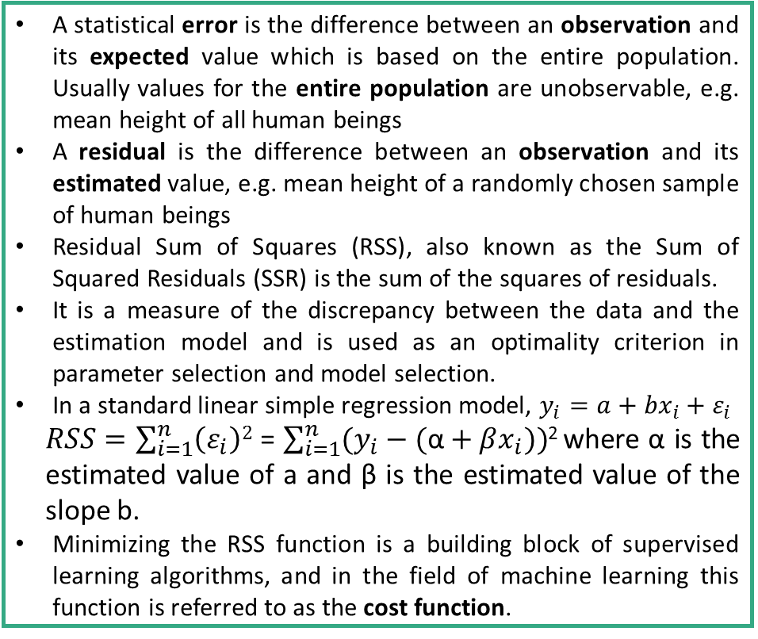
Errors & Residuals
A statistical error is the difference between an observation and its expected value which is based on the entire population. Usually values for the entire population are unobservable, e.g. mean height of all human beings
A residual is the difference between an observation and its estimated value, e.g. mean height of a randomly chosen sample of human beings
Residual Sum of Squares (RSS), also known as the Sum of Squared Residuals (SSR) is the sum of the squares of residuals.
It is a measure of the discrepancy between the data and the estimation model and is used as an optimality criterion in parameter selection and model selection.
In a standard linear simple regression model, $y_{i}=a+{bx}_{i}+ε_{i}$
$RSS=$ $\sum_{i=1}^{n}{\left(ε_{i}\right)2}$ = $\sum_{i=1}^{n}{(y_{i}−(\text{α}+βx_{i}))}$² where α is the estimated value of a and β is the estimated value of the slope b.
Minimizing the RSS function is a building block of supervised learning algorithms, and in the field of machine learning this function is referred to as the cost function.

Slide 34
Graphical Example Explaining Residual
When you perform simple linear regression (or any other type of regression analysis), you get a line of best fit.
The data points usually dot sometimes fall exactly on this regression equation line; they are scattered around.
A residual is the vertical distance between a data point and the regression line. Each data point has one residual. They are positive if they are above the regression line and negative if below the line. If the line actually passes through the point, the residual at that point is zero.

Slide 35
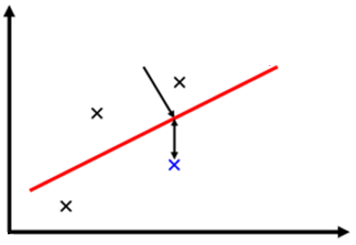










Graphical Example Explaining Residual
Say, the line has equation
y=0.8x + 5
Points are: (x1, y1) = (1, 5),
(x2, y2) = (2, 7),
(x3, y3) = (3, 6)
The corresponding residuals are: r1(-0.8), r2(0.4) and r3(-1.4)
Regression Line
$$ŷ_{3}$$
$${ŷ= b_{0}+b_{1}x}_{ }$$
$$y_{2}$$
Predicated ‘y’
$$r_{2}=(y_{2}−ŷ_{2})$$
$$r_{3}=(y_{3}−ŷ_{3})$$
$$ŷ_{1}$$
$$ŷ_{2}$$
$$y_{3}$$
Residual:y - ӯ
Observed ‘y’
$$r_{1}=(y_{1}−ŷ_{1})$$
$$y_{1}$$

Slide 36
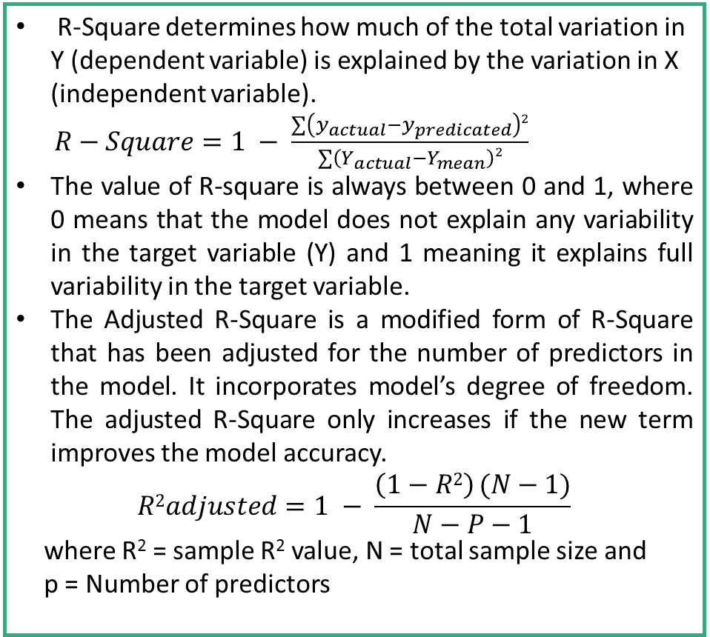
R-Square & Adjusted R Square
R-Square determines how much of the total variation in Y (dependent variable) is explained by the variation in X (independent variable).
$R−Square=1 − \frac{∑\left(y_{actual}−y_{predicated}\right)2}{∑\left(Y_{actual}−Y_{mean}\right)2}$
The value of R-square is always between 0 and 1, where 0 means that the model does not explain any variability in the target variable (Y) and 1 meaning it explains full variability in the target variable.
The Adjusted R-Square is a modified form of R-Square that has been adjusted for the number of predictors in the model. It incorporates model’s degree of freedom. The adjusted R-Square only increases if the new term improves the model accuracy.
$$R2adjusted=1 − \frac{\left(1−R2\right) (N−1)}{N−P−1}$$
where R² = sample R² value, N = total sample size and
p = Number of predictors

Slide 37
Machine Learning
Regularization

Slide 38
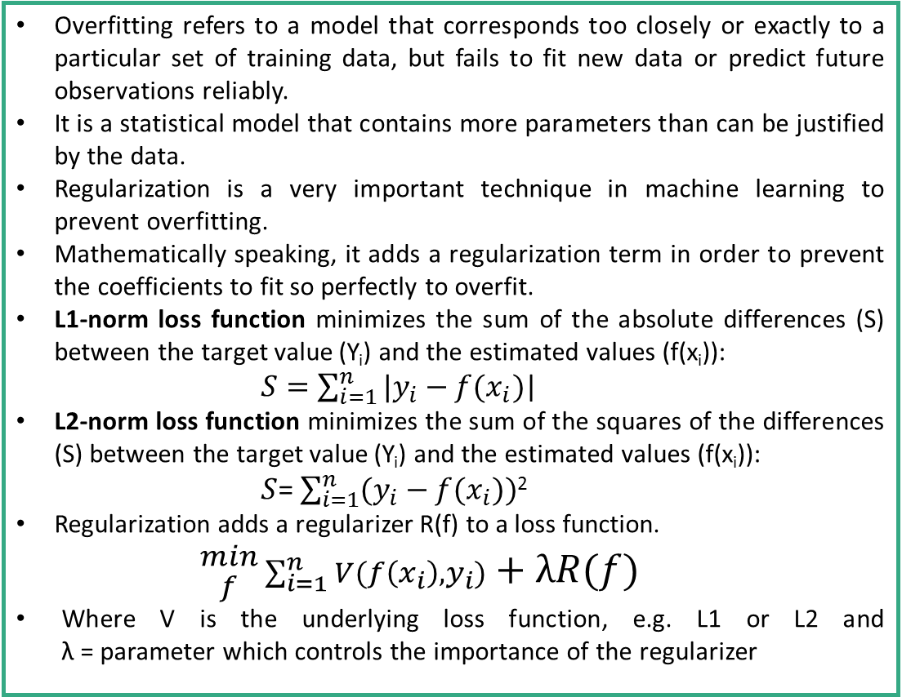
Regularization
Overfitting refers to a model that corresponds too closely or exactly to a particular set of training data, but fails to fit new data or predict future observations reliably.
It is a statistical model that contains more parameters than can be justified by the data.
Regularization is a very important technique in machine learning to prevent overfitting.
Mathematically speaking, it adds a regularization term in order to prevent the coefficients to fit so perfectly to overfit.
L1-norm loss function minimizes the sum of the absolute differences (S) between the target value (Y_{i}) and the estimated values (f(x_{i})):
$S=\sum_{i=1}^{n}{|y_{i}−f(x_{i})}$|
L2-norm loss function minimizes the sum of the squares of the differences (S) between the target value (Y_{i}) and the estimated values (f(x_{i})):
$S$= $\sum_{i=1}^{n}{(y_{i}−f(x_{i}))}$²
Regularization adds a regularizer R(f) to a loss function.
$$\begin{aligned}min \\ f\end{aligned}{\sum_{i=1}^{n}{V(f\left(x_{i}\right),y_{i})}}+λR(f)$$
Where V is the underlying loss function, e.g. L1 or L2 and λ = parameter which controls the importance of the regularizer

Slide 39
Machine Learning
Ridge & LASSO

Slide 40
Ridge & LASSO
Ridge and LASSO (Least Absolute Shrinkage and Selection Operator) regression are powerful techniques generally used for creating compact models in presence of a “large” number of features. Problem with large number of features:
Enhance the tendency of a model to overfit (as low as 10 variables might cause overfitting)
Cause computational challenges. With modern systems, this situation might arise in case of millions or billions of features

Slide 41
Ridge & LASSO
Both Ridge and LASSO work by penalizing the magnitude of coefficients of features along with minimizing the error between predicted and actual observations. The key difference is in how they assign penalty to the coefficients.
Ridge Regression:
Performs L2 regularization, i.e. adds penalty equivalent to square of the magnitude of coefficients
Minimization objective = Least Squares Objective + α * (sum of square of coefficients)
LASSO Regression:
Performs L1 regularization, i.e. adds penalty equivalent to absolute value of the magnitude of coefficients Minimization objective = Least Squares Objective + α * (sum of absolute value of coefficients)

Slide 42
Ridge & LASSO (Cont.)
Both Ridge and LASSO try to penalize the Beta coefficients so that we can get the important variables (all in case of Ridge and few in case of LASSO).
If we take α = 0, it will become Ridge and if α = 1 it is LASSO.
The major advantage of Ridge regression is coefficient shrinkage and reducing model complexity. So It is majorly used to prevent overfitting but not very useful in reducing number of features.
Along with shrinking coefficients, LASSO performs feature selection as well - some of the coefficients become exactly zero, which is means that the feature is excluded from the model. So it is useful for modelling cases where the number of features are in millions or more
Let us go for a practical demonstration…

